Slide 1

Content
Introduction to Wireshark
01
02
TCP analysis
03
ARP analysis
04
ICMP analysis

Slide 2
Network Traffic Analysis(wireshark) Overview
Speakers:
Mohammed Ali (阿里)
姚佳乐 刘钊铖
王礼昇 程嘉豪

Slide 3
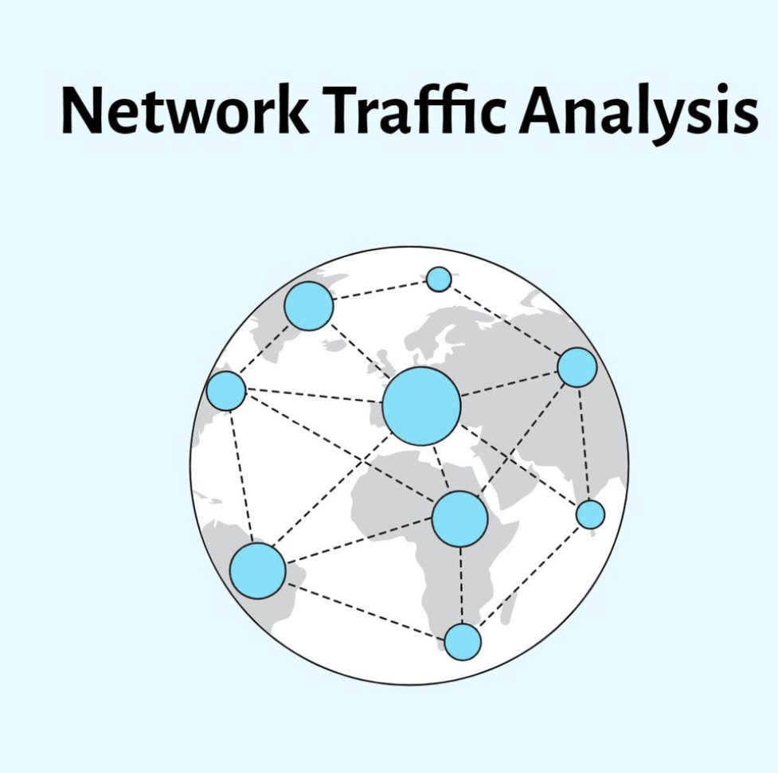
What is Network Traffic Analysis?
Network Traffic Analysis involves monitoring, capturing, and analyzing network traffic to understand what is happening on a network. This process is vital for various reasons, such as ensuring network performance, identifying security threats, troubleshooting network problems, and ensuring compliance with network policies.

Slide 4
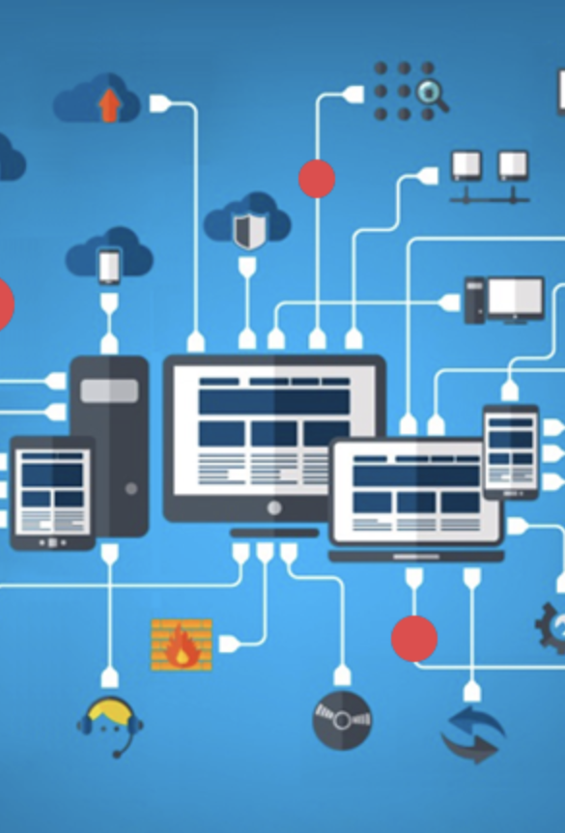
The Role of Wireshark in Network Traffic Analysis
Wireshark is one of the most popular tools used for Network Traffic Analysis. It is an open-source packet analyzer, which means it captures network packets and displays them in as much detail as possible. Wireshark is known for its powerful features:
Data Capture and Real-time Analysis: Wireshark can capture live packet data from a network interface or analyze previously captured packet files.
Detailed Inspection of Protocols: It supports hundreds of protocols and media types, allowing users to inspect individual packets in detail.
Filtering and Searching Capabilities: Users can filter packets for specific protocols, source and destination addresses, or other criteria, making it easier to analyze large amounts of data.
Graphical and Textual Analysis: Wireshark provides a graphical view of network activity as well as detailed textual information about each packet.

Slide 5

Challenges and Considerations
Complexity: The sheer volume of data and the complexity of network protocols can make analysis challenging.
Privacy and Legal Issues: Capturing and analyzing network traffic must be done in compliance with privacy laws and organizational policies.
Skill Requirement: Effective use of tools like Wireshark requires a good understanding of network protocols and analysis techniques.

Slide 6

Applications of Network Traffic Analysis
Security: Identifying suspicious activities, malware communication, and potential breaches.
Performance Monitoring: Analyzing network usage and identifying bottlenecks or other issues affecting performance.
Troubleshooting: Diagnosing network problems by examining packet-level information.
Compliance and Forensics: Ensuring compliance with network policies and conducting forensic analysis in the event of a network attack.

Slide 7
01.Introduction to Wireshark

Slide 8

Wireshark—a network analysis tool
In network communication, Wireshark is a common network protocol analysis tool that can help us capture and analyze network traffic.
Using Wireshark, you can learn about the content of network packets, including header information, transmission protocol, and data payload. Through the analysis of network traffic, we can better understand the network communication process, troubleshoot problems and optimize network performance.
Download link: https://www.wireshark.org/download.html

Slide 9
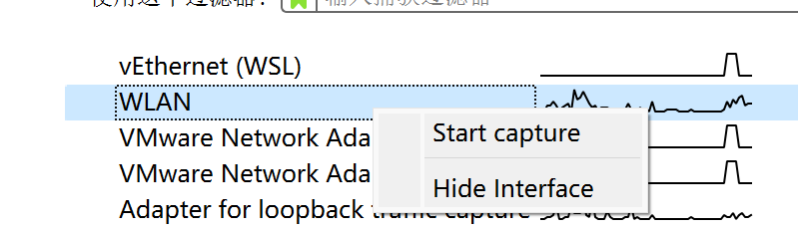
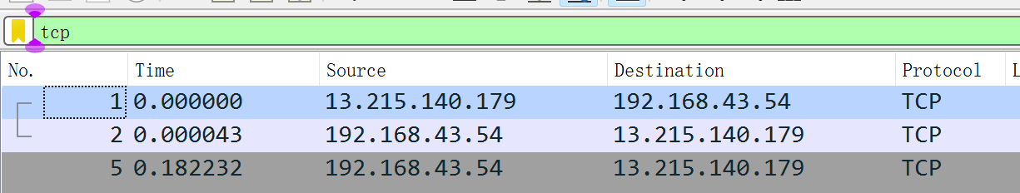
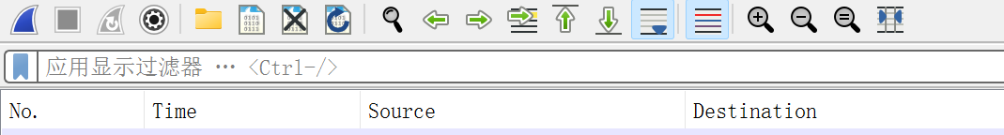
How to use Wireshark
Several common filtering commands to be used for experiments:
1. Filtering out captured protocol-specific messages.If you want to filter out tcp message: segments:
Click “Start capture”
Wireless Local Area Network（WLAN）is the network card that the wireshark needs to detect
2. Filter out host-specific messages
ip.addr == xxx.xxx.xxx.xxx
Setting up filters
3. Use the “and” concatenation
If you want to filter out tcp message and the server’s IP address is xxx.xxx.xxx.xxx
ip.addr == xxx.xxx.xxx.xxx and tcp
Filters can filter out messages for specific protocols, for specific hosts (IP)

Slide 10
Some common-used commands in Windows
ping + destination IP address/domain name
Using the ping command, we can send an Internet Control Message Protocol (ICMP) echo request to the target host and wait for the response.
The executing result includes the Round-Trip Time (RTT) and packet loss rate of each packet.
telnet [options] [host [port]]
The Telnet command is used to remotely log in and manage computers. It opens a virtual terminal window on the local computer through the Telnet protocol and establishes a connection with the target computer, enabling users to execute commands or operations on the remote computer.

Slide 11
Some common used commands in Windows
Ipconfig
Ipconfig is used to view and manage IP addresses, subnet masks, default gateways, and other information related to network connections for network interfaces. By running the ipconfig command, we can obtain the current network configuration information of our computer.

Slide 12
02.TCP protocol analysis

Slide 13
seq and ack
Data to be transferred(byte stream, index begins at 0) client
0 | 1 | 2 | 3 | 4 | 5 | 6 | 7 | 8 | 9 | 10 | 11 | 12 | 13 | 14 | 15 | 16
x and y is the initial sequence number, they are random.
What is ack?
When server receive this TCP segment. It received x to x+4, the next expected seq is x+5, so the server gives a ack = x+5 to client
TCP segment
X | X+1 | X+2 | X+3 | X+4
Data to be transferred(byte stream, index begins at 0) server
0 | 1 | 2 | 3 | 4 | 5 | 6 | 7 | 8 | 9 | 10 | 11 | 12 | 13 | 14 | 15 | 16
TCP segment
y | y+1 | y+2 | y+3 | y+4

Slide 14
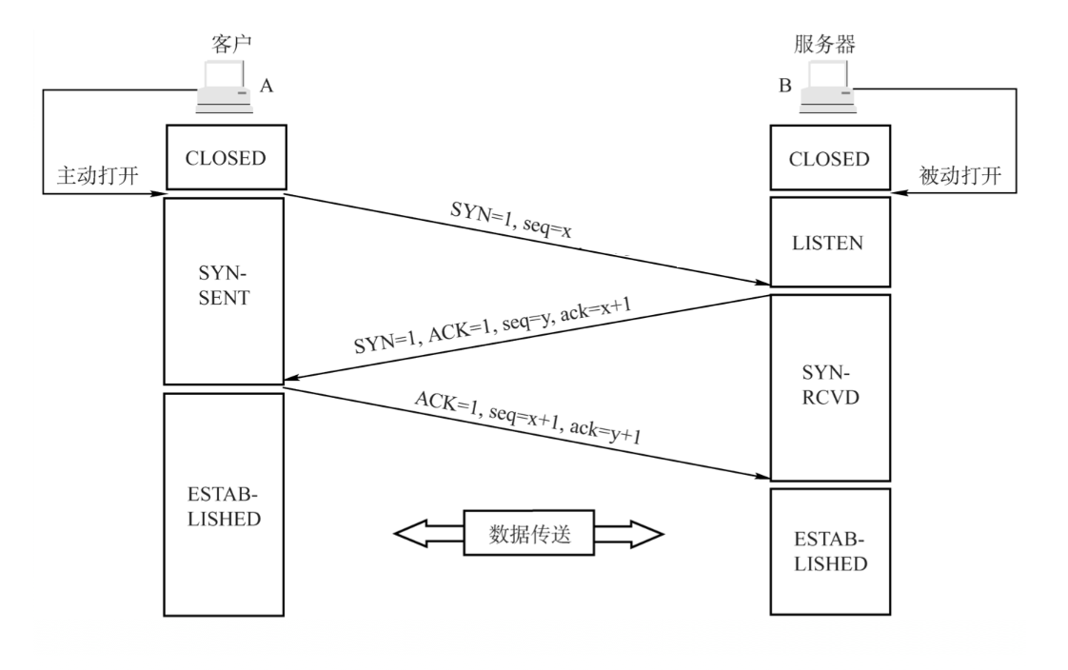
TCP: three-hand-shaking
seq num x and y is random
①The client sends a SYN message to the server indicating the client's initialization sequence number ISN (x)
②When the server receives a SYN message from the client, it sends a SYN message as an answer (SYN = 1) and specifies its own initialization sequence number ISN(y)
③ After the client receives the server's response to the SYN message, it will send an ACK message, also the same as the server's ISN + 1 as the value of the ack, indicating that it has received the SYN message from the server, and it hopes to receive the first byte of the next data with the serial number of y + 1, and specifies that at this time the client's serial number, seq = x + 1.
SYN: used to synchronize when establishing a connection
seq: The first data byte in the message segment
ack: The seq number of the next byte wish to receive

Slide 15
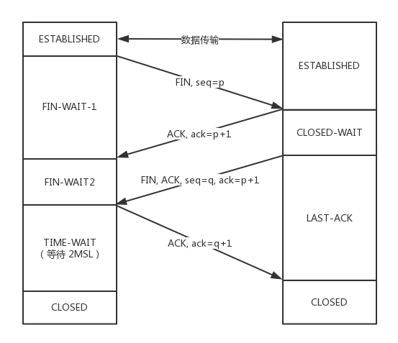
TCP: four-way-handshake
1) First wave: the client sends a FIN message (request for connection termination: FIN = 1), in which a sequence number seq = u is specified.
2) The second wave: after the server receives the FIN, it will send the ACK message and take the client's serial number value +1 as the sequence number value of the ACK message, indicating that it has received the client's message.
3) Third wave: If the server also wants to disconnect (no data to be sent to the client), send a FIN message as in the client's first wave, and specify a sequence number.
(4) The fourth wave: after the client receives the FIN, it sends an ACK message as an answer (ack = w+1) and takes the server's sequence value +1 as the value of its own ACK message's sequence number (seq = u+1)

Slide 16
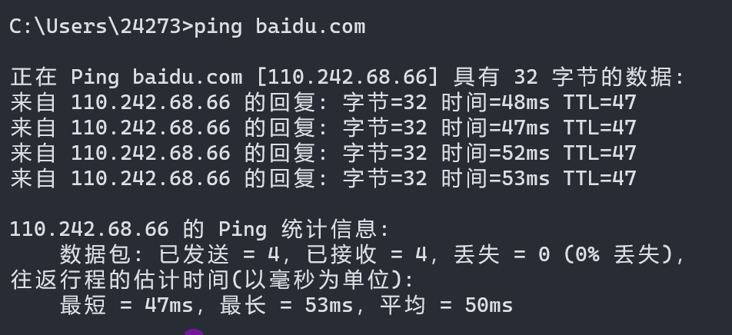
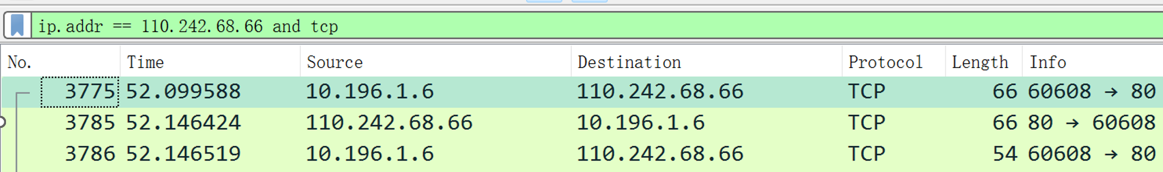
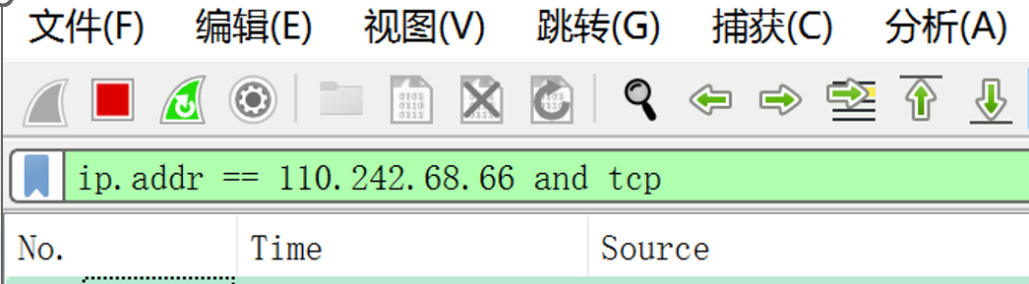
Lab Process:Successful TCP three-hand-shaking
1. Get the Baidu server’s IP address by ping command
3. Input the command “telnet Baidu.com 80” in the terminal.
Telnet is a remote terminal service based on the TCP/IP protocol. telnet can be used to connect to remote servers and test network connectivity.
2. Set up the filtering conditions in wireshark and turn on capture
Result

Slide 17
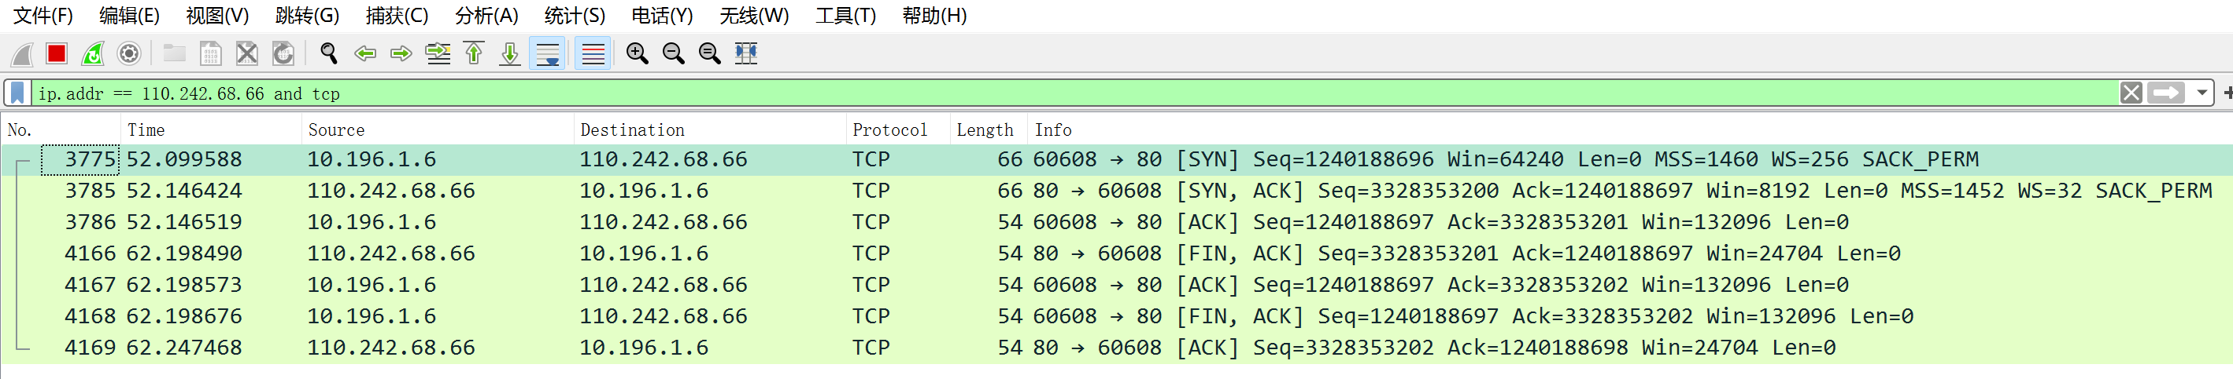
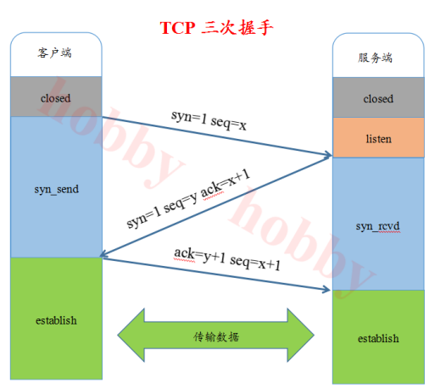
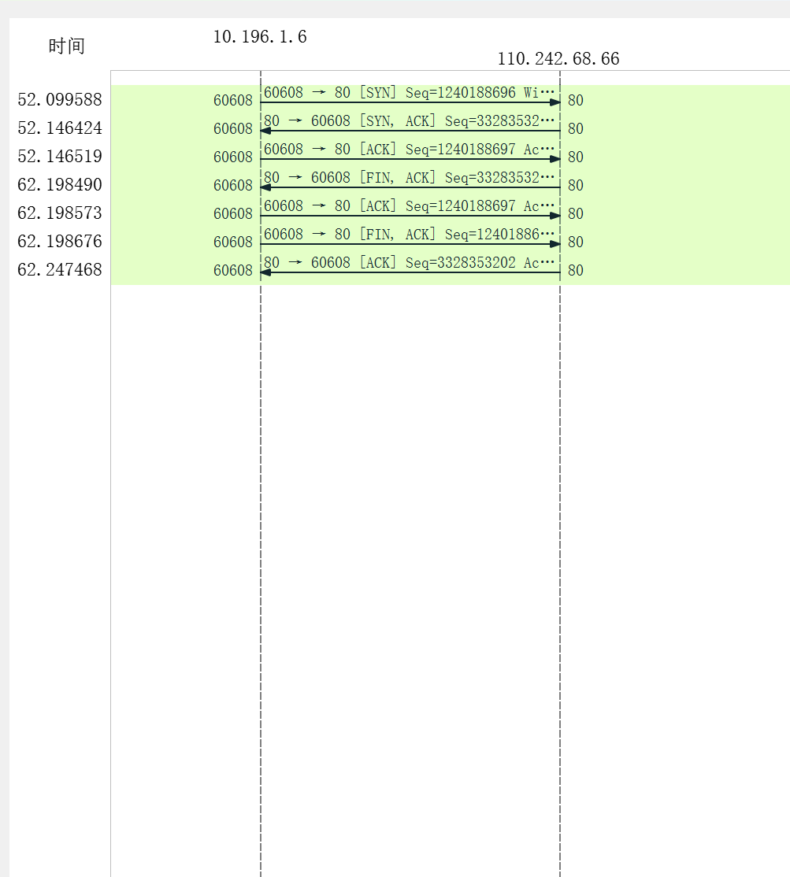
Packet analysis
The first three packets are three handshakes, and the last four packets are four handshakes
You can see that the port number on which the local host communicates with the server is 60608, and the port number on which the server communicates is the default port 80

Slide 18
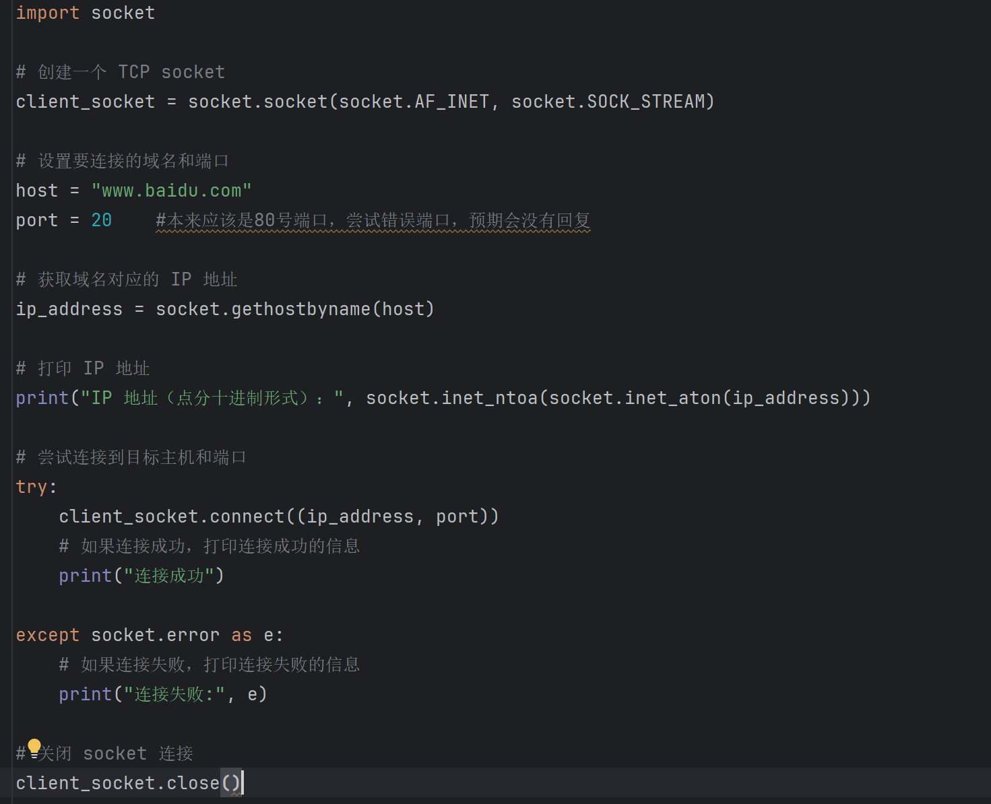

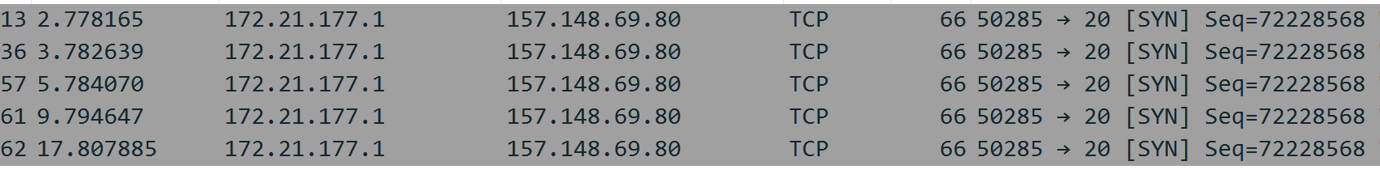
https://www.baidu.com == https://www.baidu.com:80 When we visit baidu, the last 80 port can usually be omitted
Lab Process:Bad TCP three-hand-shaking
wrong server’s port ---> Unsuccessful TCP connection --->
Bad three-hand-shaking
No response. Repeat five times
The obtained server IP address is used as a filter.

Slide 19
03.ARP（Address Resolution Protocol）

Slide 20
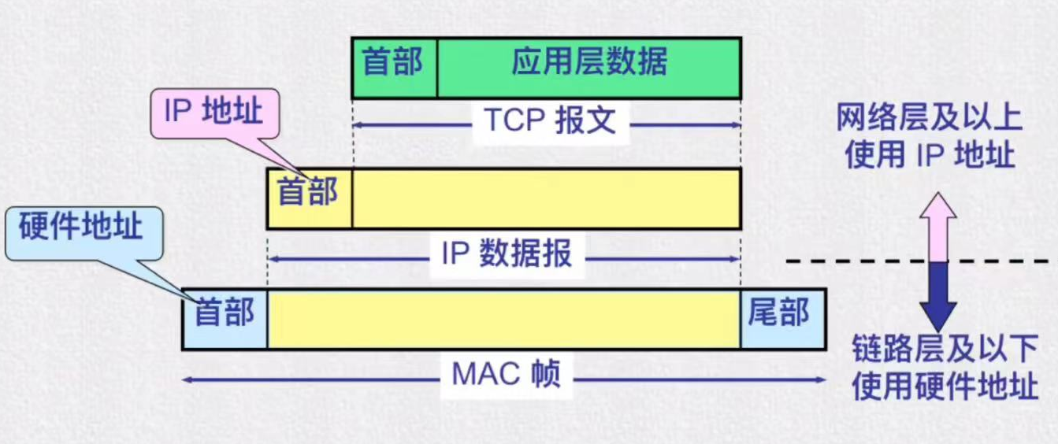
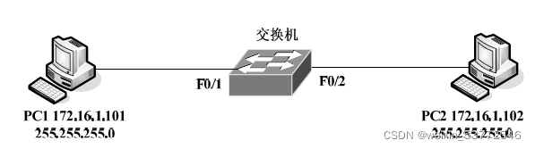
Introduction to ARP
ARP is responsible for mapping IP addresses to physical addresses (such as Ethernet MAC addresses). In practical communication, physical networks use hardware addresses to transmit packets.
When IP packets are encapsulated into data link layer frames for transmission, it is necessary to convert the IP address into its corresponding hardware address. ARP dynamically completes this function.

Slide 21
ARP Workflow
Step1
PC1 checks its local ARP cache table.
If PC1 find the corresponding entry in cache table, it’s fine. Otherwise go to step 2.
Step2
PC1 broadcasts the ARP request frame to all hosts in the local network. The frame includes PC1’s IP address and MAC address
Now if PC1 wants to send data to PC2, then it needs to find MAC address of PC2.
Each host checks if the requested IP address matches its own IP address. If no, it adds PC1’s IP and MAC address to local cache table and ignore the request.

Slide 22
ARP Workflow
Step 3
When PC2 receives the ARP request, it will send back its MAC address to PC1(unicast). Also it add PC1’s address to its ARP table.
Step 4
Now PC1 gets the MAC address of PC2 and adds to its ARP table. And PC1 can start sending data to PC2.
Now if PC1 wants to send data to PC2, then it needs to find MAC address of PC2.

Slide 23
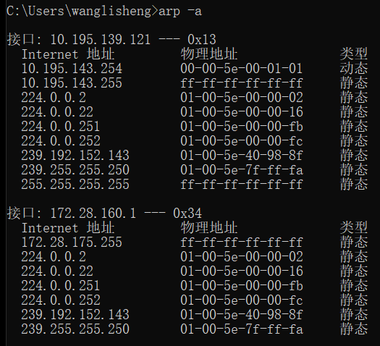
ARP cache table
We can use arp –a command in Windows to check the ARP cache table in the local host.
Some other commands about ARP table include:
arp -d Deleting table entries
arp -s Adding stable table entries

Slide 24
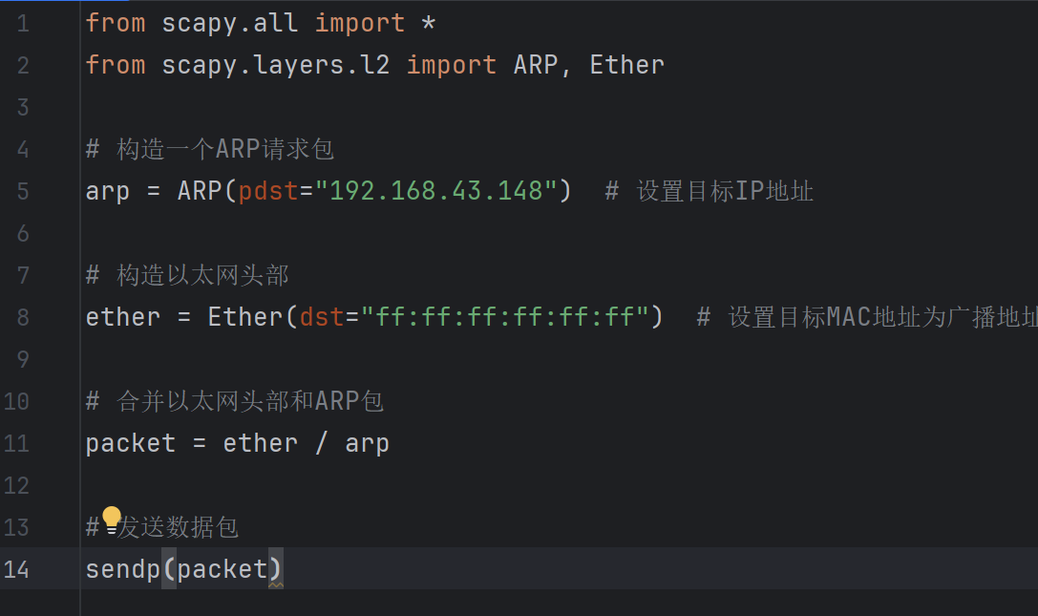
ARP test
We connect PC1 and PC2 to the same LAN by connecting them to the same mobile’s WiFi.
And then using ipconfig command to get PC2’s IP address.
Then we can run the following code to request for PC2’s MAC address.
Set the request target IP address as PC2’s IP address.
Set MAC address as all 1s for broadcasting.

Slide 25
ARP test
Then through wireshark, we can catch the packets and analyze their detailed information.
PC1 broadcasts its ARP request.
PC2 responds to PC1.

Slide 26
04.ICMP analysis

Slide 27
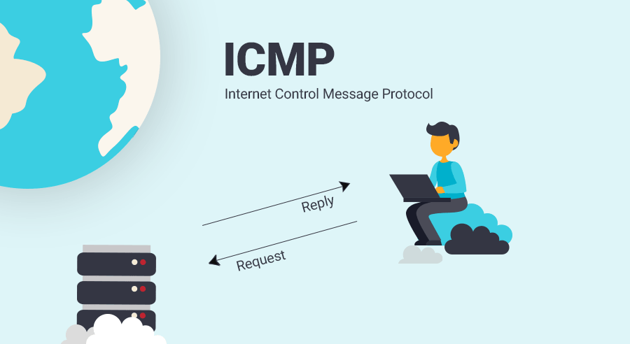
1.Introduction to ICMP
ICMP is the abbreviation of Internet Control Message Protocol. It is one of the core protocols of the Internet Protocol family. It is used in TCP/IP networks to send control messages to provide feedback on various problems that may occur in the communication environment, through which network managers can diagnose the problems that occur and then take appropriate measures to solve them。

Slide 28
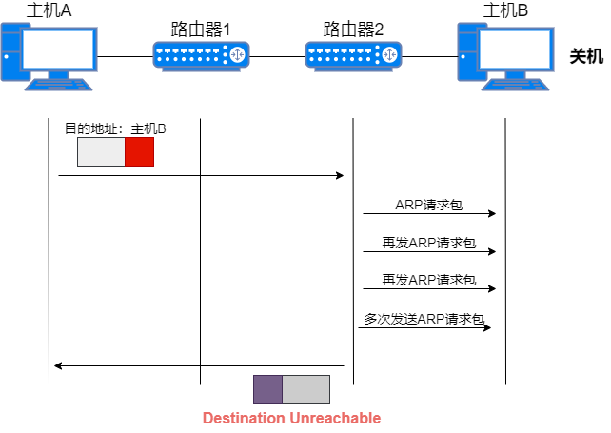
2.Key features of ICMP
The first function of ICMP is to confirm whether the IP packet can successfully reach the destination address, when two devices are connected through the Internet, if the IP packet sent by either device to the other device does not arrive, an ICMP packet will be generated and sent to the device share

Slide 29
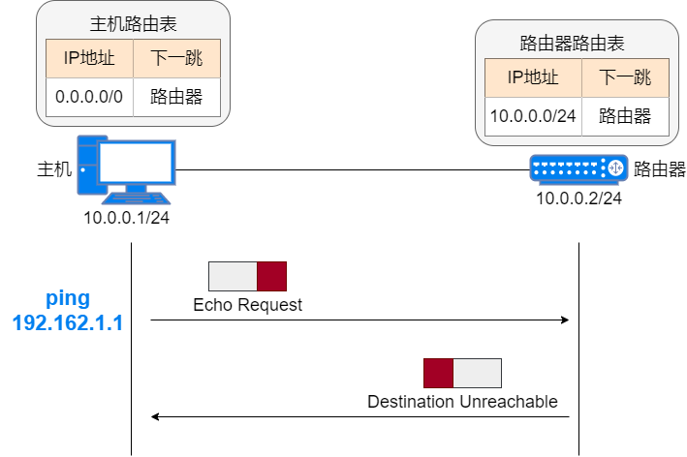
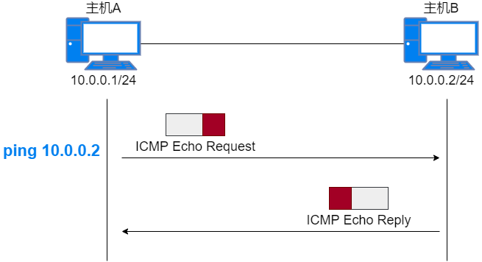
2.Key features of ICMP
The second function of ICMP is to perform network diagnostics, and the two endpoint programs that often use ICMP packets are ping and traceroute, the traceroute program is used to show the possible path between two Internet devices and measure the latency of the packet on the IP network. The ping procedure is a simplified version of traceroute, and we often use the ping command to test whether two devices are interconnected, and the ping is often used to test the connection speed between two hosts, and to accurately report the time it takes for a packet to reach its destination and return.

Slide 30
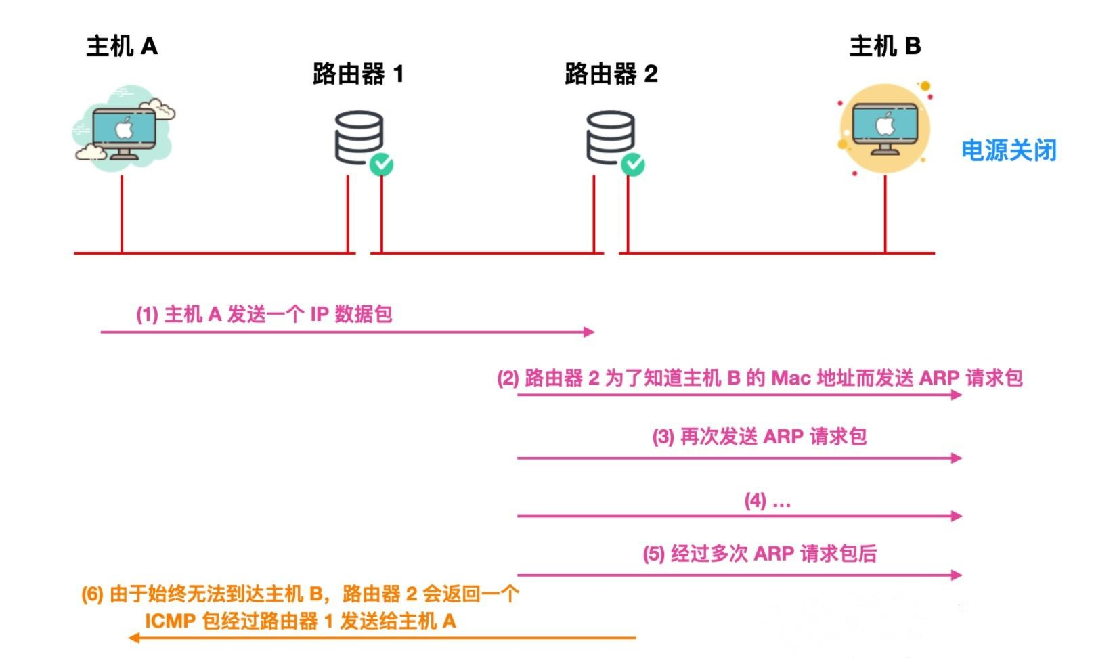
3. Background of the experiment
If an IP packet fails to reach the destination host for some reason during an IP communication, ICMP will notify you of this specific reason, as shown in an ICMP notification diagram

Slide 31
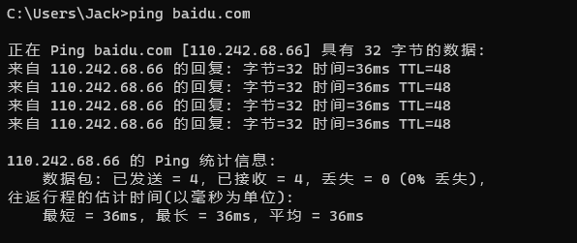
4. Procedure of ICMP experiment
Step1. The first step is performed to capture and analyze the ping www.baidu.com:
Ping is a command used to test network connectivity. Once the ping command is issued, the host sends a continuous test packet to the network, and in normal cases, the host receives a response packet using the ICMP protocol。

Slide 32
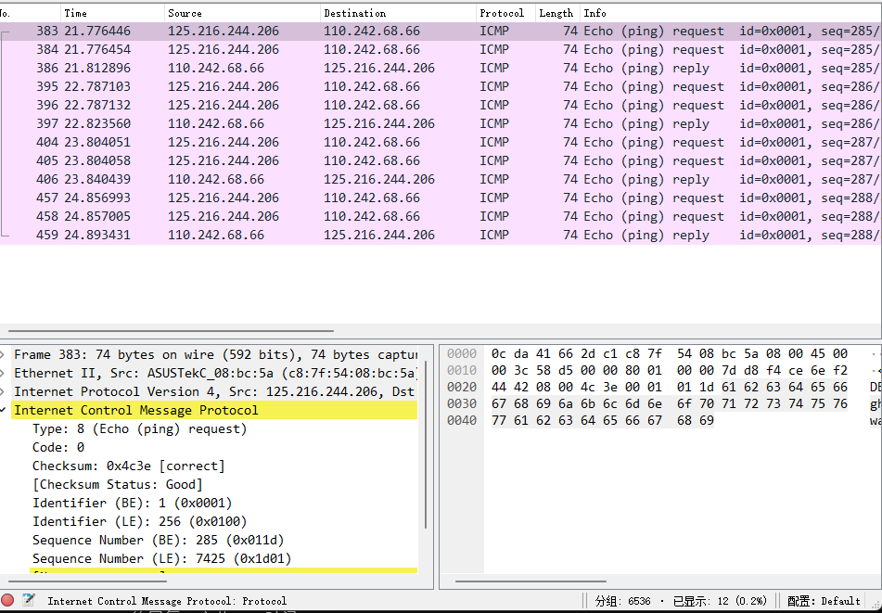
Step2. Configure filters: Filter for protocols, ping uses ICMP, capture filters are used before packet capture, and filtering is set to icmp
Step3. Start packet capture: Click [start] to start capturing packets
As you can see, pings are performed 6 times by default in Windows, so Wireshark catches 12 ICMP query packets based on the request and response process

Slide 33
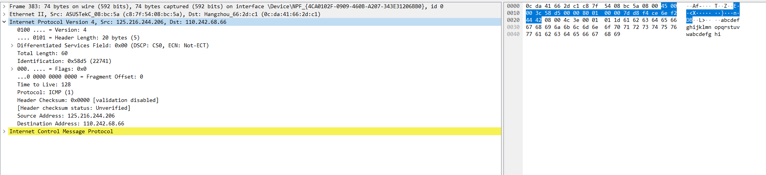

Step4. Analyze the data packet and select a data packet for analysis
The blue part is the IP header, which has a total of 20 bytes.

Slide 34
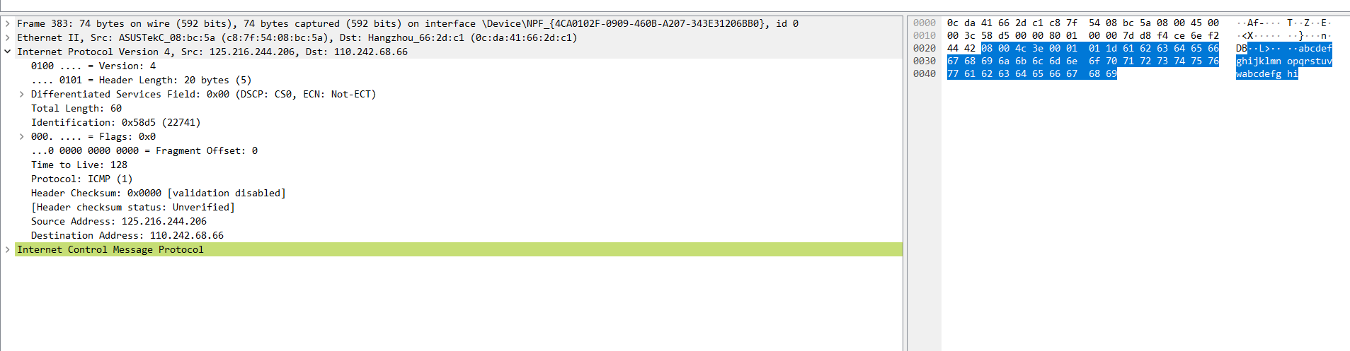

Step4. Analyze the data packet and select a data packet for analysis
The blue part is an ICMP packet with a total of 40 bytes

Slide 35
Thank You
Speakers:
姚佳乐 刘钊铖
王礼昇 程嘉豪

